Slide 1
Quadratic Programming
Katie Novacek
Dan Xue
Mingna Zheng
April 7, 2011

Slide 2
Description
A linearly constrained optimization problem with a quadratic objective function is called a quadratic program. The quadratic program is expressed in the form

Slide 3
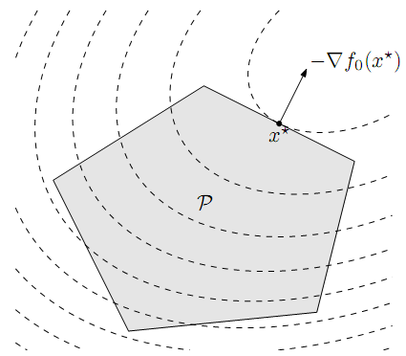
Geometrically
A quadratic programming minimizes a convex quadratic function over a polyhedron. As shown, P is a feasible set and the contour lines of the objective function are the dashed curves. The point x* is optimal

Slide 4
Types of Problems
Convex Problem
H is positive semi-definite
Any local minimizer is global
H = 0 linear programming
Strictly Convex Problem
H is positive definite
A unique minimizer (if any exists)
Non-Convex Problem
H may be indefinite
There may be many local minimizers
Problem may be unbounded from below

Slide 5

First Order Optimality
To solve, we introduce the Lagrangian function $L\left(x\right)=f\left(x\right)+λ\left(Ax−b\right)$where λ is the n-dimensional row vector (number of constraints).

Slide 6
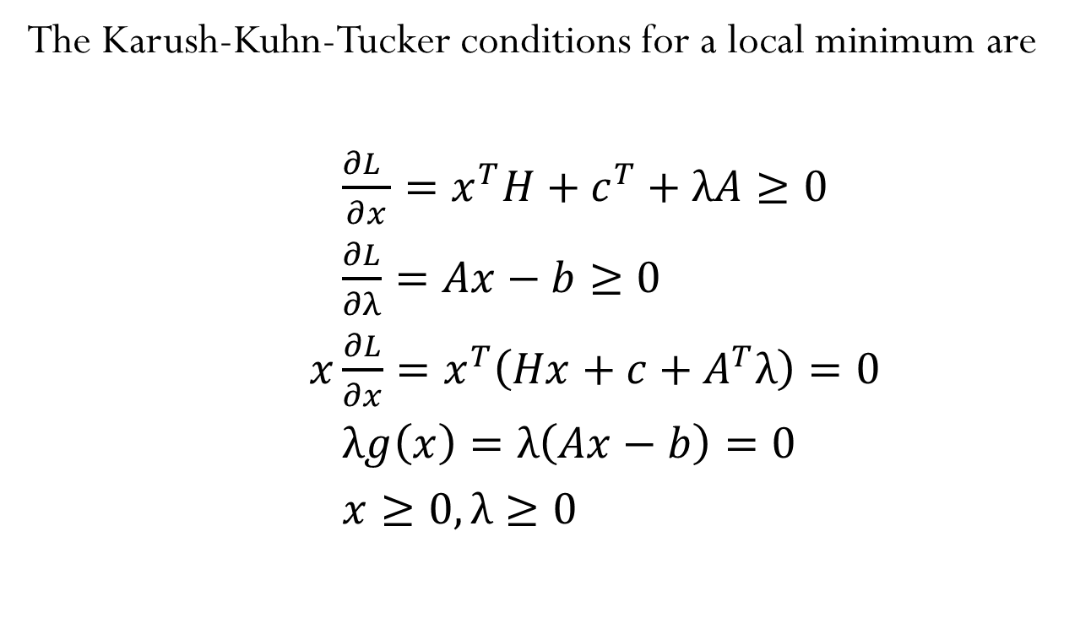
First Order Optimality cont.
The Karush-Kuhn-Tucker conditions for a local minimum are
$\frac{∂L }{∂x}=x^{T}H+c^{T}+λA≥0$
$\frac{∂L}{∂λ}=Ax−b≥0$
$x\frac{∂L}{∂x}=x^{T}\left(Hx+c+A^{T}λ\right)=0$
$λg\left(x\right)=λ\left(Ax−b\right)=0$
$x≥0,λ≥0$

Slide 7
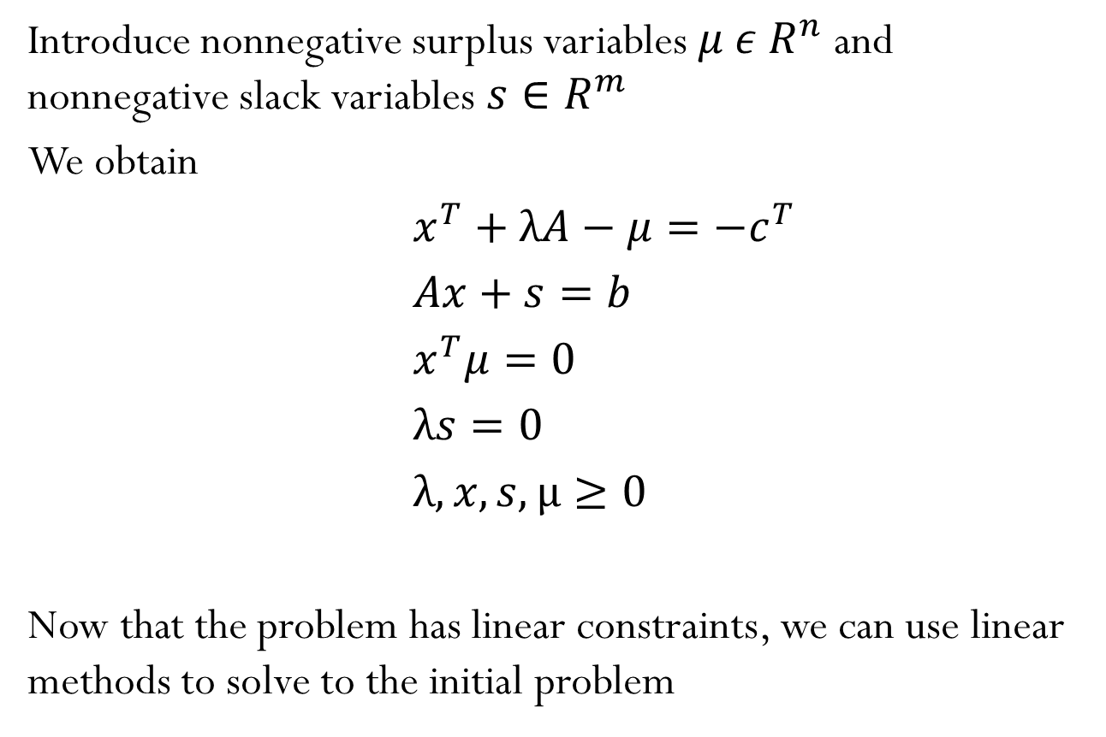
First Order Optimality cont.
Introduce nonnegative surplus variables $μ ε R^{n}$ and nonnegative slack variables $s∈R^{m}$
We obtain
$x^{T}+λA−μ=−c^{T}$
$Ax+s=b$
$x^{T}μ=0$
$λs=0$
$λ,x,s,µ≥0$
Now that the problem has linear constraints, we can use linear methods to solve to the initial problem

Slide 8

Second Order Optimality
Where $x∈R^{n}$is the optimization variable, $A_{i}∈R^{n_{i}xn}$, and $F∈R^{pxn}$

Slide 9
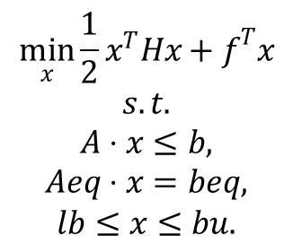
QP in Matlab
Formula
[x,fval,exitflag,output,lambda] = …
quadprog(H,f,A,b,Aeq,beq,lb,ub,x0,options)
Large-scale: an interior reflective Newton method coupled with a trust region method.

Slide 10
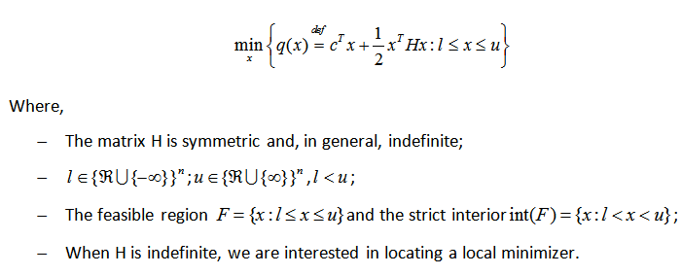
Quadratic programming problems
Formula

Slide 11
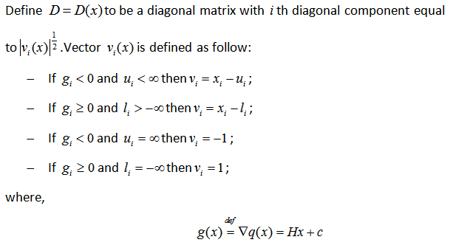
Optimality conditions
Diagonal matrix D

Slide 12
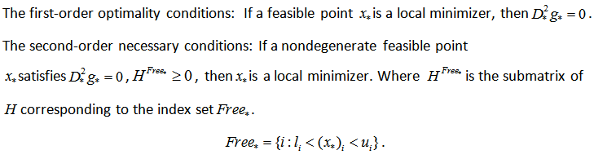
Optimality conditions
First-order condition
Secondorder condition

Slide 13
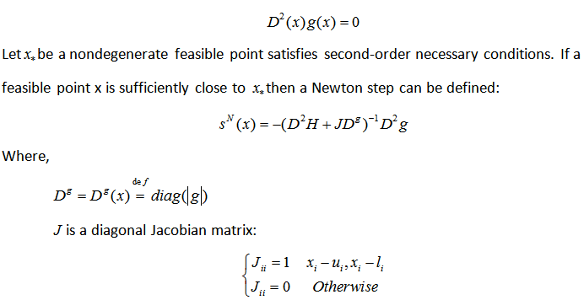
Interior reflective Newton method
The end game

Slide 14
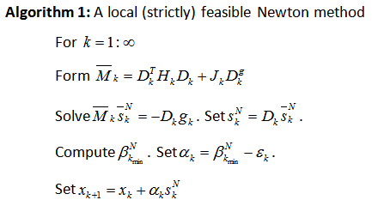
Interior reflective Newton method

Slide 15
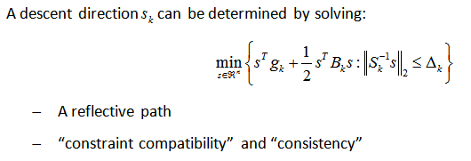
Interior reflective Newton method
The middle game

Slide 16
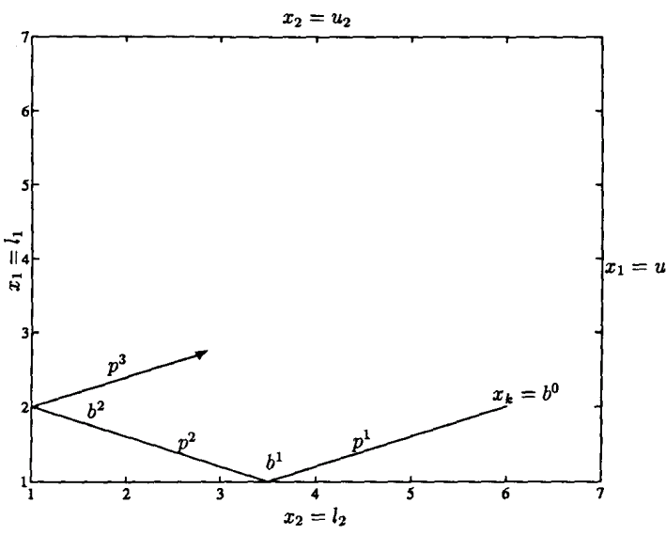
Interior reflective Newton method
Reflective line search

Slide 17
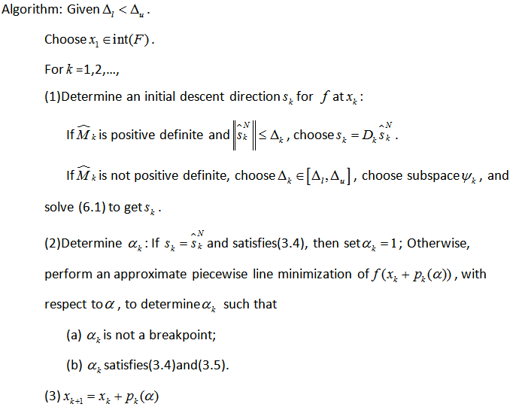
Interior reflective Newton method

Slide 18
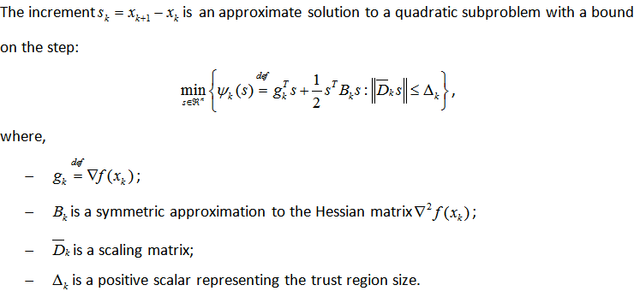
Trust region methods
Basic idea

Slide 19
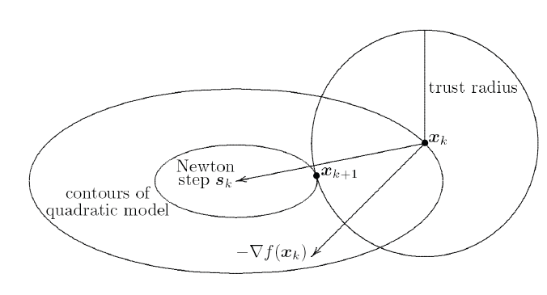
Trust region methods

Slide 20
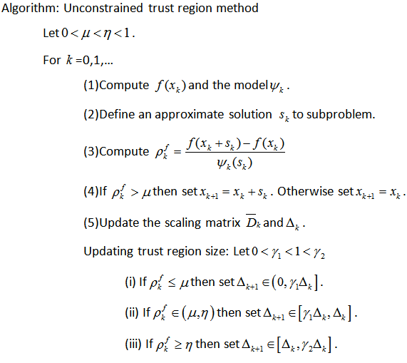
Trust region methods
Unconstrained trust region method

Slide 21
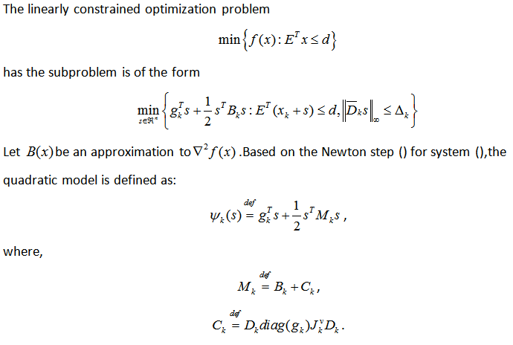
Trust region methods
Trust region method for bound-constrained problems

Slide 22
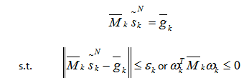
Preconditioned conjugate gradient(PCG)

Slide 23


Medium-Scale QP Problem
Active Set Method
according to the KK conditions, we need to look for a
vector (x; λ) such that x satisfies the constraints set and
(x; λ) satisfies following:

Slide 24
Phase 1 -- calculation of an inital feasible point x₀
A point x is said to be feasible if it satisfies all the constraints S
Solving the following equations to find x₀ :

Slide 25


Phase 2 -- generation of an iterative sequence of feasible points that converge to the solution
where is the step length, and is the QP search direction.

Slide 26
Matlab example
6 dimensions and 4 constraint s problem
H = [ 36 17 19 12 8 15;
17 33 18 11 7 14;
19 18 43 13 8 16;
12 11 13 18 6 11;
8 7 8 6 9 8;
15 14 16 11 8 29];
f = [ 20 15 21 18 29 24 ]';
A = [ 7 1 8 3 3 3;
5 0 5 1 5 8;
2 6 7 1 1 8;
1 0 0 0 0 0 ];
b = [ 84 62 65 1 ]';
options = optimset ('largescale','off');
xsol = quadprog(H,f,[],[],A,b,[],[],[],options)
xsol = 1.000, -2.3027, 9.5138, -0.0467, -0.1972,1.3097
Application example: portfolio optimization
data is determined by the expected return of the investments and the covariance of the returns.
solve for the optimal weighting of the investments by minimizing the variance in the portfolio while requiring the sum of the weights to be unity

Slide 27
Reference
Boyd, Stephen and Lieven Vandenberghe. Convex Optimization. Cambridge University Press.
Jensen, Paul A. and Jonathan F. Bard. Nonlinear Programming Methods: Quadratic Programming. Operations Research Models and Methods.
Medium-Scale quadprog Algorithm
On the convergence of reflective Newton methods for large-scale nonlinear minimization subject to bounds, Math. Programming, 67 (1994), pp. 189-224.
Prof. G. Srinivasan. Department of Management Studies, IIT Madras. Youtube Video: Lec-35: Quadratic Programming.
T. F. COLEMAN AND Y. LI, A Reflective Newton Method for Minimizing a Quadratic Function Subject to Bounds on the Variables, Tech. report TR 92-1315, Computer Science Department, Cornell University, Ithaca, NY, 1992.

